Slide 1
Using The Crypto Module
Name : B.Anjaneyulu
Roll No:22H51A05E2

Slide 2

Introduction to the Crypto Module
The crypto module is a built-in library in Node.js that provides cryptographic functionality.
It allows developers to implement encryption, decryption, hashing, and signature verification.
This module is essential for securing data in applications, ensuring integrity and confidentiality.
1
Notes:
Image source: https://metaschool.so/articles/nodejs-crypto-module/

Slide 3
Key Features of the Crypto Module
The crypto module supports various cryptographic algorithms, including AES, RSA, and SHA.
It provides utilities for creating secure random numbers and generating key pairs.
Developers can use the module to create message authentication codes (MACs) for data validation.
2
Notes:
Image source: https://www.researchgate.net/figure/Cryptographic-module-and-application-flow-for-our-architecture_fig4_224237239

Slide 4
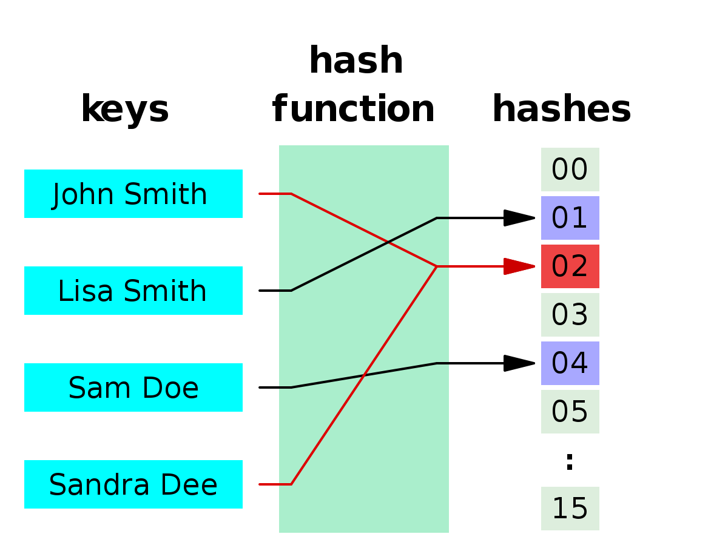
Working with Hash Functions
Hash functions are used to produce a fixed-size output from variable-sized input data.
The crypto module allows you to create hashes using algorithms like SHA-256 and SHA-512.
Hashing is commonly used for storing passwords securely and verifying data integrity.
3
Notes:
Image source: https://notlaura.com/data-structures-day-4-i-made-a-hash-table/

Slide 5
Symmetric Encryption
Symmetric encryption uses the same key for both encryption and decryption processes.
The crypto module provides methods for implementing symmetric algorithms like AES.
It is crucial to manage and store encryption keys securely to maintain data confidentiality.
4
Notes:
Image source: https://chandabdulsalam.medium.com/aes-symmetric-encryption-with-client-server-model-typescript-c-ee9b773babb9

Slide 6
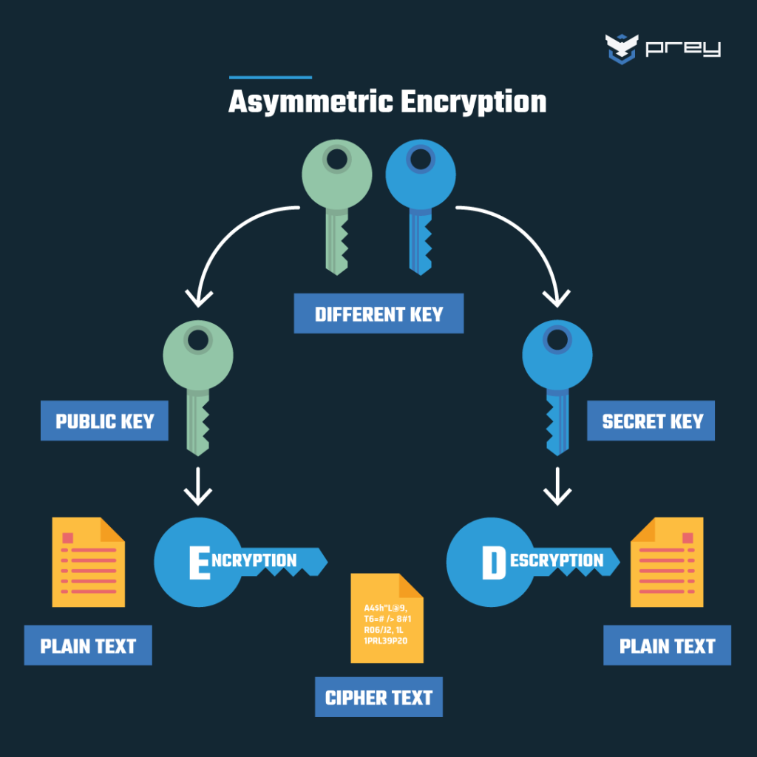
Asymmetric Encryption
Asymmetric encryption uses a pair of keys: a public key for encryption and a private key for decryption.
The crypto module offers support for RSA, which is a widely used asymmetric algorithm.
This type of encryption is often used in secure communications and digital signatures.
5
Notes:
Image source: https://preyproject.com/blog/types-of-encryption-symmetric-or-asymmetric-rsa-or-aes

Slide 7

Digital Signatures
Digital signatures ensure the authenticity and integrity of a message or document.
The crypto module allows you to create and verify digital signatures easily.
By signing data with a private key, you can confirm the sender's identity and guarantee data integrity.
6
Notes:
Image source: https://www.tutorialandexample.com/how-does-digital-signature-work

Slide 8
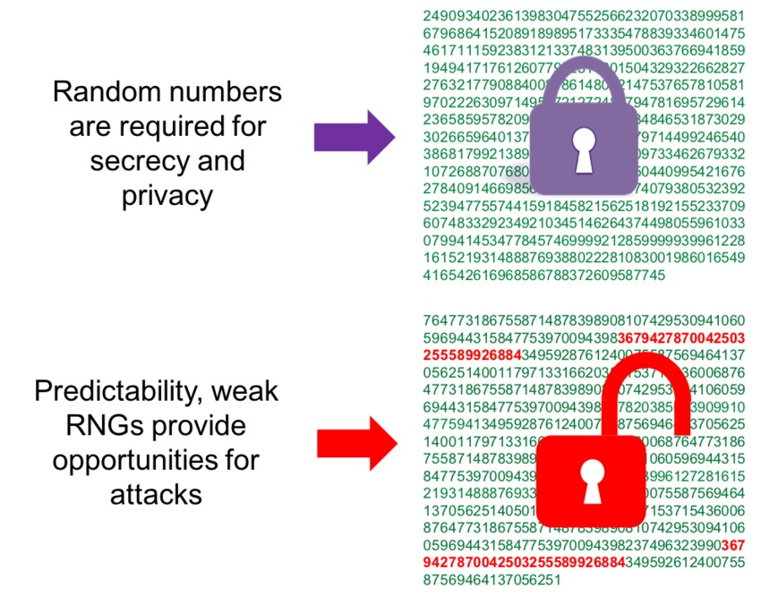
Secure Random Numbers
Secure random numbers are crucial for cryptographic operations such as key generation.
The crypto module provides a method called `randomBytes` to generate secure random data.
Using secure random numbers helps prevent predictable outcomes and enhances security.
7
Notes:
Image source: https://www.synopsys.com/designware-ip/technical-bulletin/true-random-number-generator-security-2019q3.html

Slide 9

Conclusion
The crypto module is a powerful tool that enhances the security of Node.js applications.
Developers should follow best practices for key management and algorithm selection.
Proper implementation of the crypto module can significantly mitigate security risks in applications.
Feel free to modify any part of the presentation as per your specific requirements!
8
Notes:
Image source: https://www.mobindustry.net/blog/11-web-application-security-best-practices-you-need-to-know/

